Slide 1


Using Latex and Overleaf to write articles and longer pieces of written work
cdcs@ed.ac.uk

Slide 2



@EdCDCS
For all events, news, and support: cdcs.ed.ac.uk

Slide 3
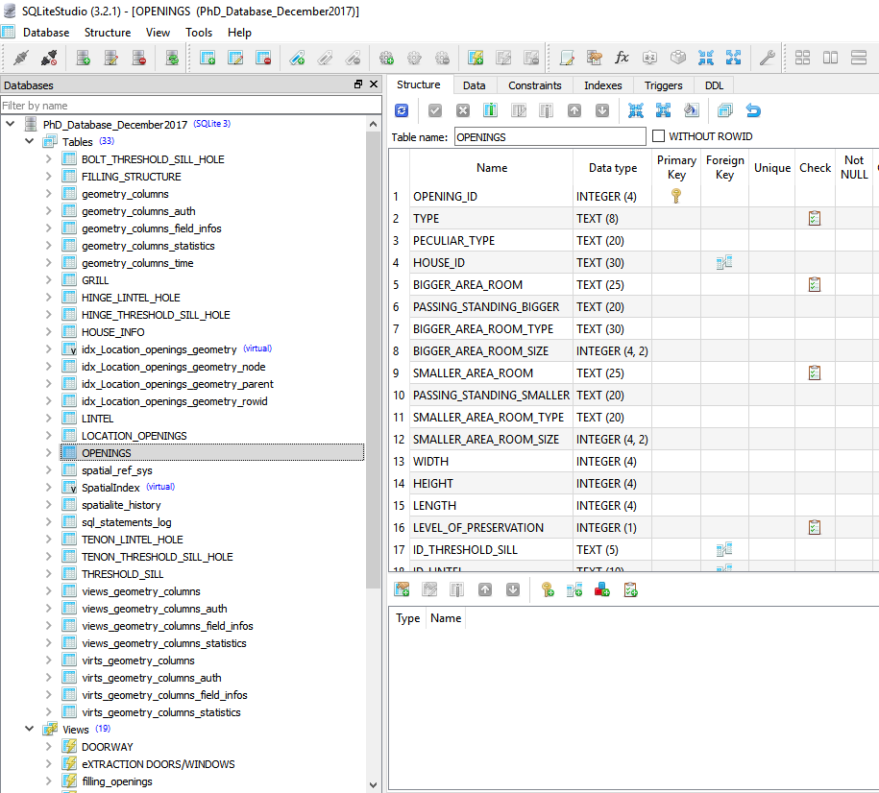
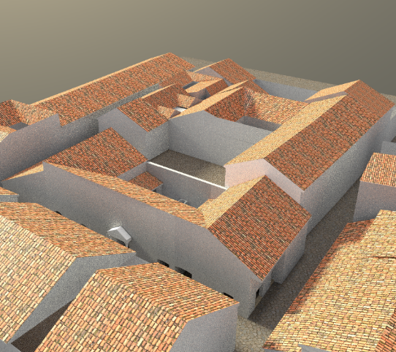
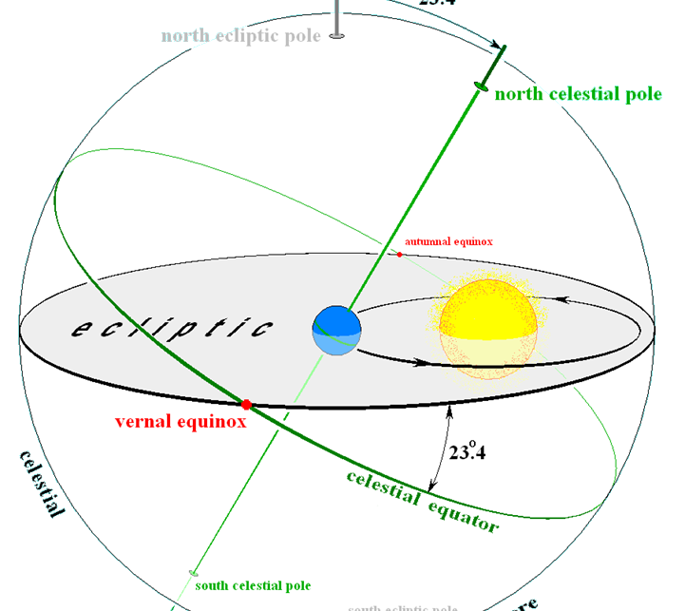


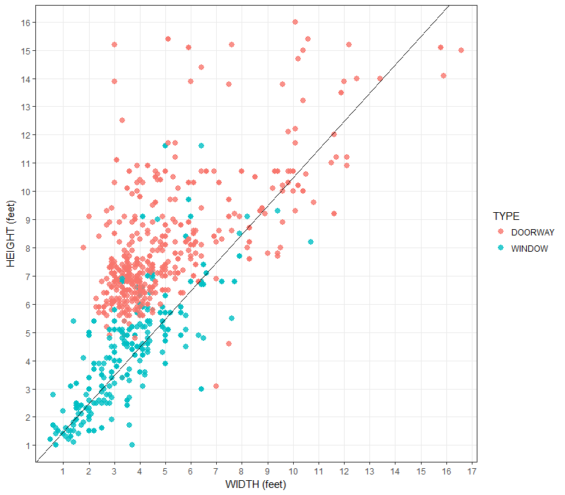
Before starting …
Who am I
I obtained a Phd in Classic from UEd
Training Manager with DCS

Slide 4

Today program
What is LaTeX? And what is Overleaf? Why use them?
Different types of Documents
Writing your first piece of LaTeX
The preamble of a document
Adding a title, author and date
Bold, Italics and Underlining
Formatting
Using Colours
www.cdcs.ed.ac.uk

Slide 5

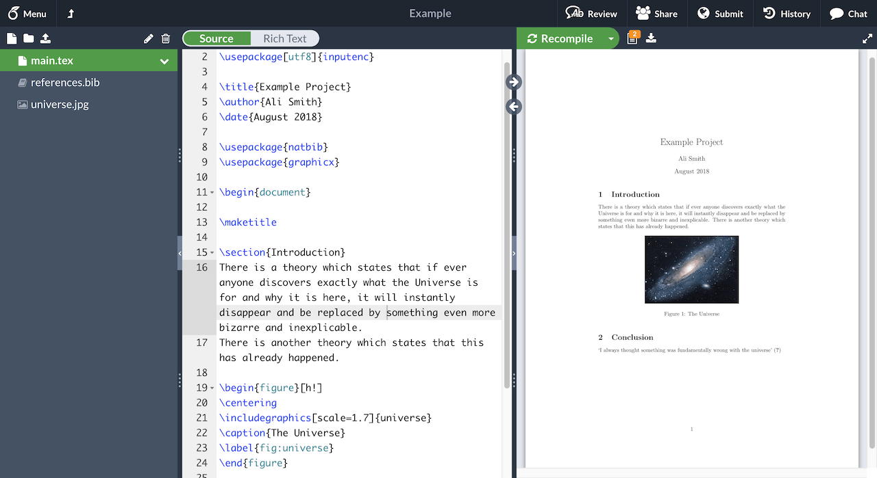

What is Latex?
LATEX (pronounced LAY-tek or LAH-tek) is a tool used to create professional-looking documents. It is based on the WYSIWYM (what you see is what you mean) idea, meaning you only have focus on the contents of your document and the computer will take care of the formatting. Instead of spacing out text on a page to control formatting, as with Microsoft Word or LibreOffice Writer, users can enter plain text and let LATEX take care of the rest.
www.cdcs.ed.ac.uk

Slide 6

Why learning Latex?
LATEX is used for scientific documents, books, as well as many other forms of publishing.
It allows users to very quickly tackle the more complicated parts of typesetting automatically (e.g. Table of Content)
Packages allow users to add footnotes, draw schematics, create tables etc.
It separates the content of the document from the style. This means that once you have written the content of your document, we can change its appearance with ease.
You can create one style of document which can be used for many different documents.
Many scientific journals to create templates for submissions. These templates have a pre-made layout meaning that only the content needs to be added.
There are hundreds of templates available for everything from CVs to slideshows.
www.cdcs.ed.ac.uk

Slide 7
Why not learning Latex?
Take time to learn it
Some journals want the .docx file
You do not need much formatting
You do not want to image google results of Latex
www.cdcs.ed.ac.uk

Slide 8

What is Overleaf?
Overleaf is a startup and social enterprise that builds modern collaborative authoring tools to help make science and research faster, more open and more transparent.
Overleaf’s market-leading collaboration technology is now in use by over four million researchers, students, and teachers in institutions, labs, and industry worldwide.
Basically is a web-based tool using Latex to create and share documents.
It allows you to create and modify texts in Latex and work collaboratively.
Not open but you have access to the pro version with your university e-mail.
Lots of models available (not many from the Edinburgh University).
www.cdcs.ed.ac.uk

Slide 9
Why using Overleaf?
Fewer bugs to deal with regarding document compilation
Save space on your computer
Work everywhere
No worries about updates
Direct submission to some journals
Interconnection with Git and Github to work in version control
Easy collaboration
Let’s Create an account
https://www.overleaf.com/edu/edinburgh
www.cdcs.ed.ac.uk

Slide 10
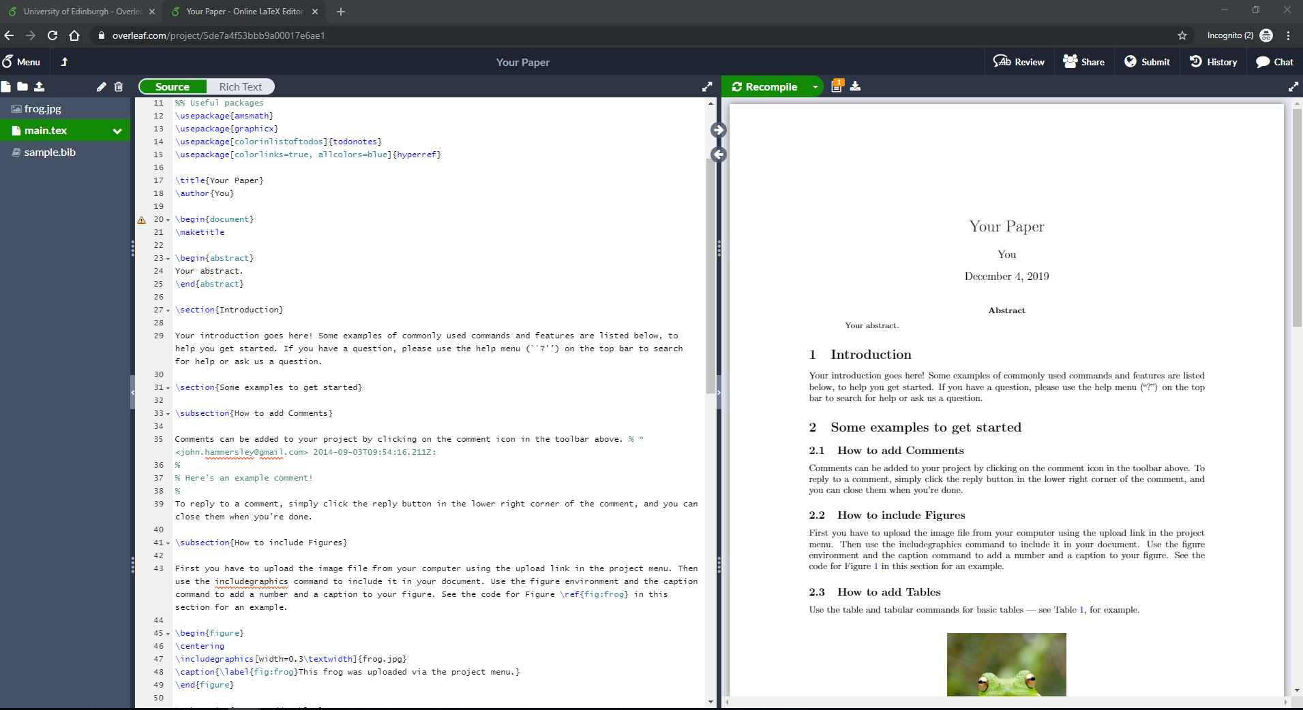
The Overleaf interface
www.cdcs.ed.ac.uk

Slide 11

Anatomy of Overleaf files
A .Tex file that contains text and command
A .bib file that contains the bibliography
Any additional files: pictures, graphs etc…
Additional .cls or .sty files that contains specific documents classes or styles
Many different types of docs
https://www.overleaf.com/read/jzxjhxggtsnh
www.cdcs.ed.ac.uk

Slide 12
The preamble of a document
\documentclass{book}
\usepackage[utf8]{inputenc}
\title{example}
\author{Lucia Michielin}
\date{December 2019}
\begin{document}
\maketitle
\section{Introduction}
\end{document}
Type of document
Type of encoding
Title of your document
Author/s
Date
Start of the proper document
Write the title
Start of the first section
End of the document
www.cdcs.ed.ac.uk

Slide 13
Adding a title, author and date
\title{{Bla Bla Bla\\
Bla Bla subtitle}\\
[15 pt]{\large Institution}\\
[45 pt]{\includegraphics
[width=0.25\textwidth]{logo.png}}}%
\author{Your Name}
\date{November 2021}
Title
Subtitle on a new row
Institution on smaller font
Add image
Image
Author
Date
www.cdcs.ed.ac.uk

Slide 14
Bold, Italic, underlining
\textit{everything in here is italic}
\textbf{everything in here is bold}
\underline{everything in here is underlined}
www.cdcs.ed.ac.uk

Slide 15
Today program
Text Alignment
Using Colour
Table of Contents
Working with images
Chapter and Sections
Tables
Lists
Formula and equations
www.cdcs.ed.ac.uk

Slide 16
Text Alignment
\begin{flushright}
All of what I write here will be right aligned
\end{flushright}
\begin{center}
All of what I write here will be centered
\end{center}
More on text alignment
https://www.overleaf.com/learn/latex/Text_alignment
www.cdcs.ed.ac.uk

Slide 17
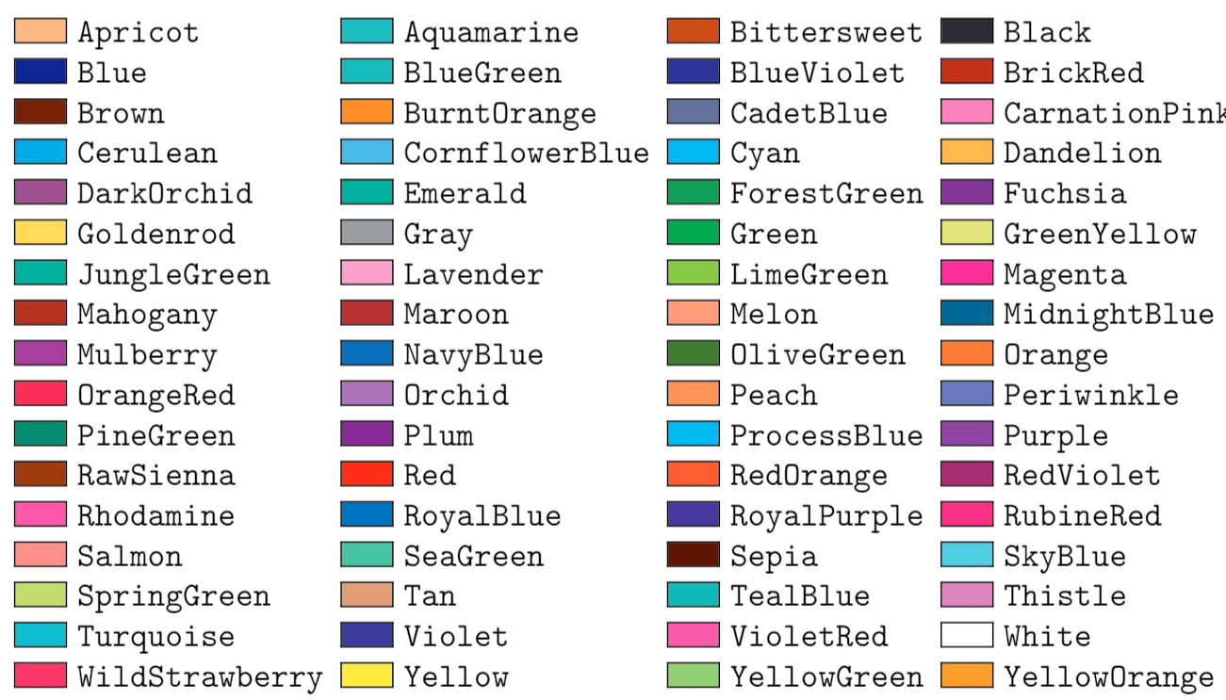
Using Colours
% Use colours
\usepackage[dvipsnames]{xcolor}
%in text
\textcolor{ForestGreen}{text to be coloured}
%Coloured line
{\color{RubineRed} \rule{\linewidth}{0.5mm}}
%Colour Box
\colorbox{BurntOrange}{orange background}
www.cdcs.ed.ac.uk

Slide 18
Table of Contexts
%set level of counting for table of content
\setcounter{tocdepth}{3}%how deep into root the display in table of content
\setcounter{secnumdepth}{3}% till when number
%add bookmark to have not in section chapters.
This is to be free to have standing alone chapter not within section in the toc
\usepackage{bookmark}
% to add for any chapter not numbered
\addcontentsline{toc}{chapter}{Lay Summary}
%Call the TOC
\tableofcontents
www.cdcs.ed.ac.uk

Slide 19
Adding images
%import and use packages for graphics and images
\usepackage{graphicx}
\usepackage{wrapfig}
\graphicspath{ {images/} }
\usepackage{caption}
\captionsetup[figure]{font=small}
www.cdcs.ed.ac.uk

Slide 20
Adding images
%Image in text
\noindent %do not indent pic
\begin{wrapfigure} %Start the package wrapped figure
{l} %aligned at left
{0.50\textwidth} %make it 50% of the width of the text
\includegraphics[width=0.50\textwidth] %add image and scale to the 50% of text
{images/Fig1.jpg} % locate image
\caption{Example of Intext image} % Caption
\label{fig:2_1} %Label of the image(image ID)
\end{wrapfigure} %End of the command
%Image all space
\begin{figure} %start the image
[h] %put the image in this exact location
\includegraphics[width=\textwidth] %add image and scale to the 100% of text
{images/Fig2.jpeg} % locate image
\caption[margin=10pt] % Caption
{This is the caption of the full text images bla bla bla} % Caption
\label{fig:7_2} %Label of the image(image ID)
\end{figure} %End of the command
www.cdcs.ed.ac.uk

Slide 21
Adding images
Specifier | Permission
h | Place the float here, i.e., approximately at the same point it occurs in the source text (however, not exactly at the spot)
t | Position at the top of the page.
b | Position at the bottom of the page.
p | Put on a special page for floats only.
! | Override internal parameters LaTeX uses for determining "good" float positions.
H | Places the float at precisely the location in the LaTeX code. Requires the float package (\usepackage{float}). This is somewhat equivalent to h!.
www.cdcs.ed.ac.uk

Slide 22
Tables
Standard centered table
\begin{table}[h!] %Start table
\centering % center table
\begin{tabular}{ |c|c|c| } %number of column or you can fix the size with { |m{5cm}|m{1cm}| m{1cm}|} need array package
\hline % horizontal line
Col1 & Col2 & Col3 \\
\hline % horizontal line
cell4 & cell5 & cell6 \\
cell7 & cell8 & cell9 \\
\hline % horizontal line
\end{tabular}
\caption{Table to test captions and labels} } %Caption table
\label{table:1} %Label table for cross ref
\end{table} %Start table
www.cdcs.ed.ac.uk

Slide 23
Lists
Bullet points
\begin{itemize} % start numbered lists
\item The labels consists of sequential numbers.
\item The numbers starts at 1 with every call to the enumerate environment.
\end{itemized} % stop numbered lists
Numbers
\begin{enumerate} % start numbered lists
\item The labels consists of sequential numbers.
\item The numbers starts at 1 with every call to the enumerate environment.
\end{enumerate} % stop numbered lists
Nested
\begin{enumerate} % start numbered lists
\item First level1.
\begin{enumerate} % start bullet lists
\item second level.
\end{enumerate} % stop numbered lists
\item First level2.
\end{enumerate} % stop numbered lists
www.cdcs.ed.ac.uk

Slide 24
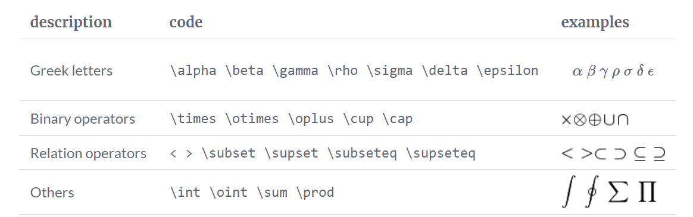
Formulas and Equations
www.cdcs.ed.ac.uk

Slide 25
Formulas and Equations
Simple unnumbered equation
\[E=mc^2\]or \(E=mc^2\)in text
Equation
\begin{equation} % start equation command
E=mc^2 % formula
\label{eq2} % Label for crossref
\end{equation} % end equation command
Multiple line solution
\begin{equation} \label{eq2} % start equation command +labelling
\begin {split} % start splitting
MyVariable & = P(s^2\cdot t)\\ % First row
& = 2.02(876.16 \cdot 0.4)\\ % Second row
& = 707.94(gr) etc.. % Third row
\end{split} % stop splitting
\end{equation} % end equation command
www.cdcs.ed.ac.uk

Slide 26
Chapters and Sections
-1 | \part{part}
0 | \chapter{chapter}
1 | \section{section}
2 | \subsection{subsection}
3 | \subsubsection{subsubsection}
4 | \paragraph{paragraph}
5 | \subparagraph{subparagraph}
www.cdcs.ed.ac.uk

Slide 27
Today program
Import snippets of code
Cross References
Footnotes
Bibliography
Import a document
Working Collaboratively
www.cdcs.ed.ac.uk

Slide 28
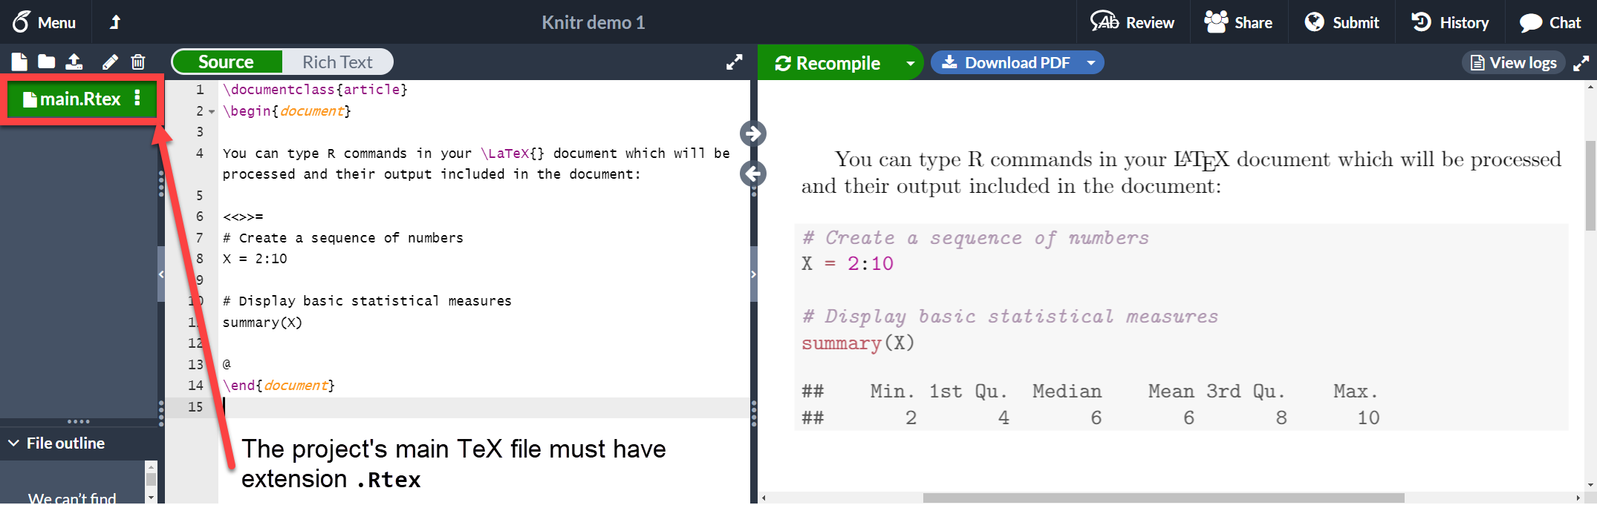
Snippets of code
\usepackage{listings}
https://www.overleaf.com/learn/latex/Knitr
www.cdcs.ed.ac.uk

Slide 29
Import Tables from R
library (tidyverse)
#Create breakout table of something
FlowersBreakout<- iris %>%
group_by(Species) %>%
summarize(meanSepal = mean(Sepal.Length), meanPetal= mean(Petal.Length), number=n())
#Install and mount required packages
install.packages("xtable")
library(xtable)
print(xtable(FlowersBreakout, type = "latex", row.names = FALSE), file = "flowers.tex")
Then import the .text file in your project and use \input{images/flowers}
www.cdcs.ed.ac.uk

Slide 30
Cross referencing images and equations
Cross Ref Figure
\ref{Figure:id}
Cross Ref Equation
\ref{Equation:id}
Cross Ref Table
\ref{Table:id}
Cross referencing will make the reference update automatically if you add more images or equation before in the chapter!
www.cdcs.ed.ac.uk

Slide 31
Footnotes
For what we normally use footnote command is very easy
\footnote{Here goes the text I want in my footnote}
More at:
https://www.overleaf.com/learn/latex/Footnotes
www.cdcs.ed.ac.uk

Slide 32
Bibliography
Cite in footnote or text
\cite{IdbookFrom.bibFile}: 73.}
Manage bibliography/citations
\usepackage{natbib}
.BIB example
@book{Croom2011,
address = {Briscombe Port Stroud, Glouchestershire},
author = {Croom, Alexandra},
publisher = {The History Press},
title = {{Running the Roman home}},
year = {2011}
}
Add bibliography
\addcontentsline{toc}{chapter}{Bibliography} % Add biblio to toc
\chapter*{Bibliography} % Call it bibliography rather than references
\markboth{Bibliography}{Bibliography} % Add biblio in header
\bibliography{References} % Add write the biblio using which file
\bibliographystyle{apalike} % Style of biblio and citation
More on Citation styles
https://www.overleaf.com/learn/latex/Biblatex_citation_styles
https://www.overleaf.com/learn/latex/Bibliography_management_with_bibtex
www.cdcs.ed.ac.uk

Slide 33
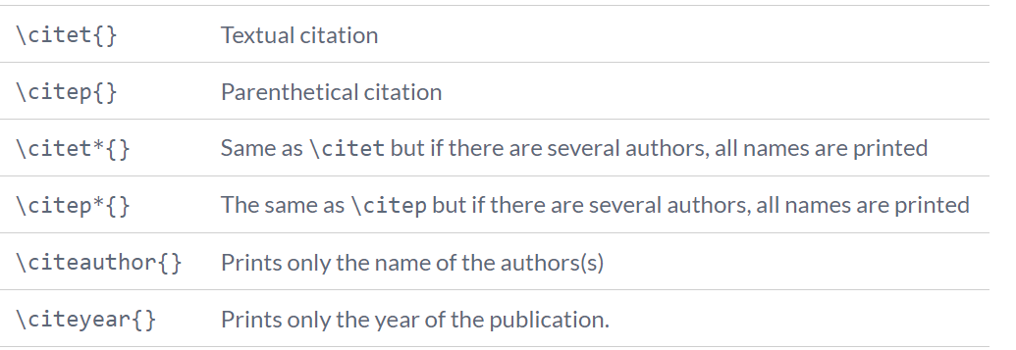
Bibliography
Natnib options
https://www.overleaf.com/learn/latex/Natbib_citation_styles
www.cdcs.ed.ac.uk

Slide 34
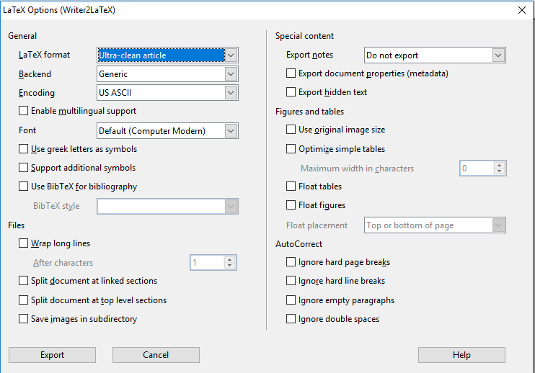
Import from Openoffice
Download the extension
https://extensions.libreoffice.org/extensions/writer2latex-1/1-6.1
You need either Open office or Libre office no free plugin for word
Go to tools > Extension manager and add the new extension
Go to Export > Select LaTeX 2e etc in file extension
Save
In overleaf navigate to the folder you want it in and upload it
www.cdcs.ed.ac.uk

